Slide 1
CONDITIONAL STRUCTURE
Computer Organization and Assembly Language
Lec #18
Computer Science Department
National University of Modern Languages
Islamabad

Slide 2
CONDITIONAL STRUCTURE
        JMP
        LOOP

Slide 3
CONDITIONAL STRUCTURES
There are no high-level logic structures such as if-then-else, in the IA-32 instruction set. But, you can use combinations of comparisons and jumps to implement any logic structure.
First, an operation such as CMP, AND or SUB is executed to modified the CPU flags. Second, a conditional jump instruction tests the flags and change the execution flow accordingly.
CMP AL, 0
JZ L1
:
L1:

Slide 4
JCOND INSTRUCTION
A conditional jump instruction branches to a label when specific register or flag conditions are met
Examples:
  JB, JC jump to a label if the Carry flag is set
  JE, JZ jump to a label if the Zero flag is set
  JS jumps to a label if the Sign flag is set
  JNE, JNZ jump to a label if the Zero flag is clear
  JECXZ jumps to a label if ECX equals 0

Slide 5
CONDITIONAL JUMPS
Jumps Based On . . .
  Specific flags
  Equality
  Unsigned comparisons
  Signed Comparisons
Applications
Encrypting a String
Bit Test (BT) Instruction

Slide 6
JCOND RANGES
Prior to the 386:
  jump must be within –128 to +127 bytes from current location counter
IA-32 processors:
  32-bit offset permits jump anywhere in memory

Slide 7
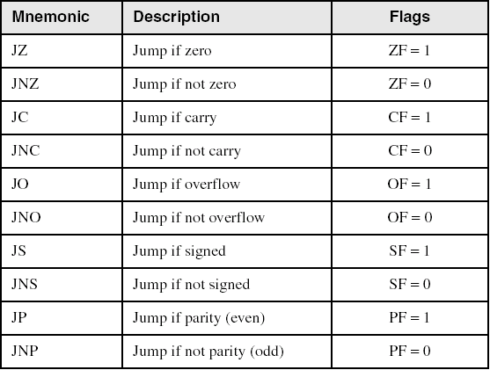
JUMPS BASED ON SPECIFIC FLAGS

Slide 8
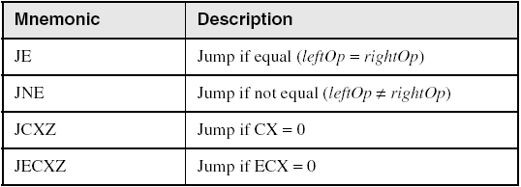
JUMPS BASED ON EQUALITY

Slide 9
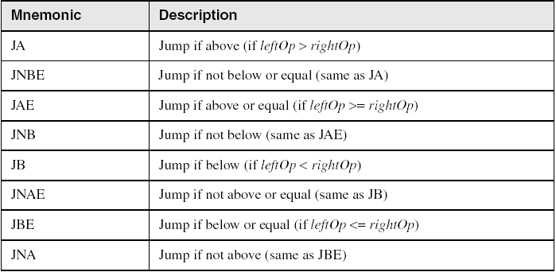
JUMPS BASED ON UNSIGNED COMPARISONS

Slide 10
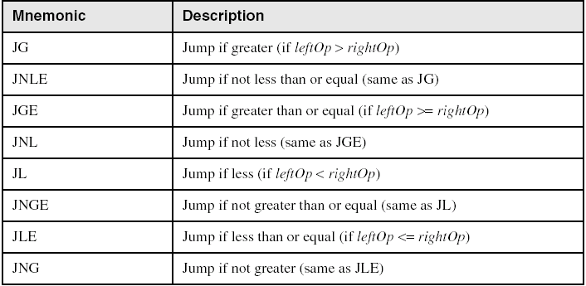
JUMPS BASED ON SIGNED COMPARISONS

Slide 11
EXAMPLE: SCANNING A ARRAY
Find the first even number in an array of unsigned integers
.date
intArray DWORD 7,9,3,4,6,1
.code
...
mov ebx, OFFSET intArray
mov ecx, LENGTHOF intArray
L1: test DWORD PTR [ebx], 1
jz found
add ebx, 4
loop L1
...

Slide 12
TEST
Computes the bit-wise logical AND of first operand (source 1 operand) and the second operand (source 2 operand) and sets the SF, ZF, and PF status flags according to the result. The result is then discarded.

Slide 13


AND INSTRUCTION
Performs a Boolean AND operation between each pair of matching bits in two operands
Syntax: (OF=0,CF=0,SF,ZF,PF)
    AND destination, source
  (same operand types as MOV)
AND

Slide 14


OR INSTRUCTION
Performs a Boolean OR operation between each pair of matching bits in two operands
Syntax: (OF=0,CF=0,SF,ZF,PF)
    OR destination, source
OR

Slide 15

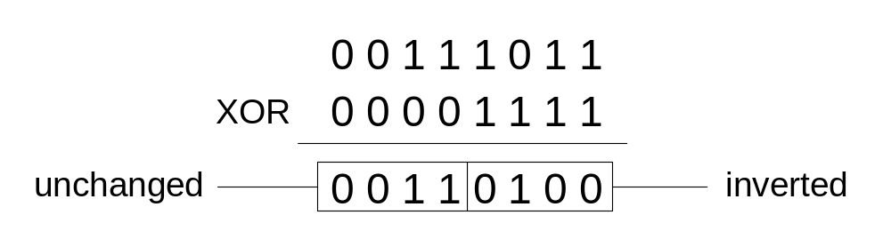
XOR INSTRUCTION
Performs a Boolean exclusive-OR operation between each pair of matching bits in two operands
Syntax: (OF=0,CF=0,SF,ZF,PF)
    XOR destination, source
XOR
XOR is a useful way to invert the bits in an operand.
Notes:
XOR with all 1’s

Slide 16

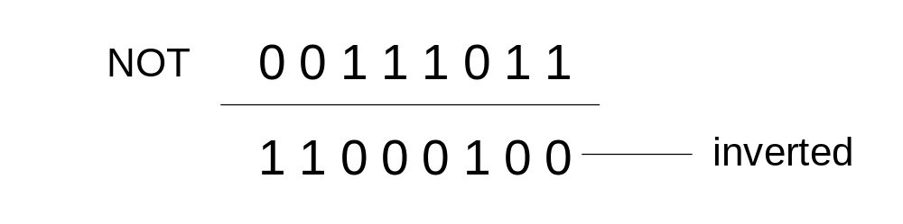
NOT INSTRUCTION
Performs a Boolean NOT operation on a single destination operand
Syntax: (no flag affected)
    NOT destination
NOT

Slide 17
APPLICATIONS (1 OF 4)
Task: Convert the character in AL to upper case.
Solution: Use the AND instruction to clear bit 5.
mov al,'a' ; AL = 01100001b
and al,11011111b ; AL = 01000001b

Slide 18
APPLICATIONS (2 OF 4)
Task: Convert a binary decimal byte into its equivalent ASCII decimal digit.
Solution: Use the OR instruction to set bits 4 and 5.
mov al,6 ; AL = 00000110b
or al,00110000b ; AL = 00110110b
The ASCII digit '6' = 00110110b

Slide 19
APPLICATIONS (3 OF 4 )
Task: Jump to a label if an integer is even.
Solution: AND the lowest bit with a 1. If the result is Zero, the number was even.
mov ax,wordVal
and ax,1 ; low bit set?
jz EvenValue ; jump if Zero flag set

Slide 20
APPLICATIONS (4 OF 4)
Task: Jump to a label if the value in AL is not zero.
Solution: OR the byte with itself, then use the JNZ (jump if not zero) instruction.
or al,al
jnz IsNotZero ; jump if not zero
ORing any number with itself does not change its value.

Slide 21
CONDITIONAL STRUCTURES
Block-Structured IF Statements
Compound Expressions with AND
Compound Expressions with OR
WHILE Loops
Table-Driven Selection

Slide 22
BLOCK-STRUCTURED IF STATEMENTS
Assembly language programmers can easily translate logical statements written in C++/Java into assembly language. For example:
if( op1 == op2 )
X = 1;
else
X = 2;
  mov eax,op1
  cmp eax,op2
  jne L1
  mov X,1
  jmp L2
L1: mov X,2
L2:

Slide 23
YOUR TURN . . .
Implement the following pseudocode in assembly language. All values are unsigned:
if( ebx <= ecx )
{
eax = 5;
edx = 6;
}
  cmp ebx,ecx
  ja next
  mov eax,5
  mov edx,6
next:
(There are multiple correct solutions to this problem.)

Slide 24
YOUR TURN . . .
Implement the following pseudocode in assembly language. All values are 32-bit signed integers:
if( var1 <= var2 )
var3 = 10;
else
{
var3 = 6;
var4 = 7;
}
  mov eax,var1
  cmp eax,var2
  jle L1
  mov var3,6
  mov var4,7
  jmp L2
L1: mov var3,10
L2:
(There are multiple correct solutions to this problem.)

Slide 25
COMPOUND EXPRESSION WITH AND (1 OF 3)
When implementing the logical AND operator, consider that HLLs use short-circuit evaluation
In the following example, if the first expression is false, the second expression is skipped:
if (al > bl) AND (bl > cl)
X = 1;

Slide 26
COMPOUND EXPRESSION WITH AND (2 OF 3)
if (al > bl) AND (bl > cl)
X = 1;
This is one possible implementation . . .
cmp al,bl ; first expression...
ja L1
jmp next
L1:
cmp bl,cl ; second expression...
ja L2
jmp next
L2: ; both are true
mov X,1 ; set X to 1
next:

Slide 27
COMPOUND EXPRESSION WITH AND (3 OF 3)
if (al > bl) AND (bl > cl)
X = 1;
But the following implementation uses 29% less code by reversing the first relational operator. We allow the program to "fall through" to the second expression:
cmp al,bl ; first expression...
jbe next ; quit if false
cmp bl,cl ; second expression...
jbe next ; quit if false
mov X,1 ; both are true
next:

Slide 28
YOUR TURN . . .
Implement the following pseudocode in assembly language. All values are unsigned:
if( ebx <= ecx
&& ecx > edx )
{
eax = 5;
edx = 6;
}
  cmp ebx,ecx
  ja next
  cmp ecx,edx
  jbe next
  mov eax,5
  mov edx,6
next:
(There are multiple correct solutions to this problem.)

Slide 29
COMPOUND EXPRESSION WITH OR (1 OF 2)
When implementing the logical OR operator, consider that HLLs use short-circuit evaluation
In the following example, if the first expression is true, the second expression is skipped:
if (al > bl) OR (bl > cl)
X = 1;

Slide 30
COMPOUND EXPRESSION WITH OR (1 OF 2)
if (al > bl) OR (bl > cl)
X = 1;
We can use "fall-through" logic to keep the code as short as possible:
cmp al,bl ; is AL > BL?
ja L1 ; yes
cmp bl,cl ; no: is BL > CL?
jbe next ; no: skip next statement
L1: mov X,1 ; set X to 1
next:

Slide 31
WHILE LOOPS
A WHILE loop is really an IF statement followed by the body of the loop, followed by an unconditional jump to the top of the loop. Consider the following example:
while( eax < ebx)
eax = eax + 1;
This is a possible implementation:
top: cmp eax,ebx ; check loop condition
jae next ; false? exit loop
inc eax ; body of loop
jmp top ; repeat the loop
next:

Slide 32
YOUR TURN . . .
Implement the following loop, using unsigned 32-bit integers:
while( ebx <= val1)
{
ebx = ebx + 5;
val1 = val1 - 1
}
top: cmp ebx,val1 ; check loop condition
ja next ; false? exit loop
add ebx,5 ; body of loop
dec val1
jmp top ; repeat the loop
next:

Slide 33
EXAMPLE: IF STATEMENT NESTED IN A LOOP
while(eax < ebx)
{
eax++;
if (ebx==ecx)
X=2;
else
X=3;
}
_while: cmp eax, ebx
jae _endwhile
inc eax
cmp ebx, ecx
jne _else
mov X, 2
jmp _while
_else: mov X, 3
jmp _while
_endwhile:

Slide 34
JMP AND LOOP INSTRUCTIONS
JMP Instruction
LOOP Instruction
LOOP Example
Summing an Integer Array
Copying a String

Slide 35
JMP INSTRUCTION
JMP is an unconditional jump to a label that is usually within the same procedure.
Syntax: JMP target
Logic: EIP ← target
Example:
top:
.
.
jmp top
A jump outside the current procedure must be to a special type of label called a global label
Globaltop::
.
.
jmp Globaltop

Slide 36
LOOP INSTRUCTION
The LOOP instruction creates a counting loop
Syntax: LOOP target
Logic:
  ECX ← ECX – 1
  if ECX != 0, jump to target
Implementation:
  The assembler calculates the distance, in bytes, between the offset of the following instruction and the offset of the target label. It is called the relative offset.
  The relative offset is added to EIP.

Slide 37
LOOP EXAMPLE
The following loop calculates the sum of the integers 5 + 4 + 3 +2 + 1:
offset machine code source code
00000000 66 B8 0000 mov ax,0
00000004 B9 00000005 mov ecx,5
… … …
00000009 66 03 C1 L1: add ax,cx
0000000C E2 FB loop L1
0000000E
When LOOP is assembled, the current location = 0000000E (offset of the next instruction). –5 (FBh) is added to the the current location, causing a jump to location 00000009:
00000009 ← 0000000E + FB

Slide 38
YOUR TURN . . .
If the relative offset is encoded in a single signed byte,
(a) what is the largest possible backward jump?
(b) what is the largest possible forward jump?
−128
+127

Slide 39
YOUR TURN . . .
mov ax,6
mov ecx,4
L1:
inc ax
loop L1
What will be the final value of AX?
10
How many times will the loop execute?
mov ecx,0
X2:
inc ax
loop X2
4,294,967,296

Slide 40
NESTED LOOP
If you need to code a loop within a loop, you must save the outer loop counter's ECX value.
.data
count DWORD ?
.code
mov ecx,100 ; set outer loop count
L1:
mov count,ecx ; save outer loop count
mov ecx,20 ; set inner loop count
L2: .
  .
  loop L2 ; repeat the inner loop
mov ecx,count ; restore outer loop count
loop L1 ; repeat the outer loop

Slide 41
SUMMING AN INTEGER ARRAY
The following code calculates the sum of an array of 16-bit integers.
.data
intarray WORD 100h,200h,300h,400h
.code
  mov edi,OFFSET intarray ; address of intarray
  mov ecx,LENGTHOF intarray ; loop counter
  mov ax,0 ; zero the accumulator
L1:
  add ax,[edi] ; add an integer
  add edi,TYPE intarray ; point to next integer
loop L1 ; repeat until ECX = 0

Slide 42
YOUR TURN . . .
What changes would you make to the program on the previous slide if you were summing a doubleword array?

